Slide 1
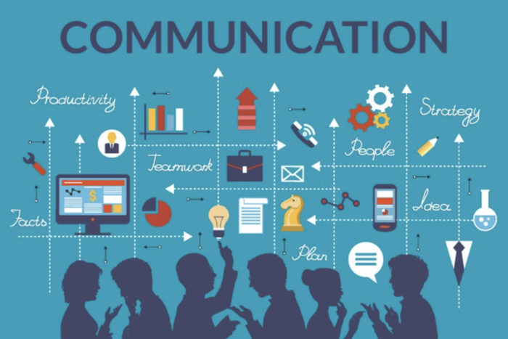
Title : “Mastering Professional Communication”
Subtitle: "Keys to Success in Workplace Communication"
Presented By -
Name : D . V Sai subha Varshini
Roll No : 23XO1E0057

Slide 2
Introduction
Definition of Professional Communication:
Professional communication involves the exchange of information in a clear, concise, and respectful manner within a business context, fostering understanding and collaboration among team members.
Importance of Effective Communication in the Workplace:
Enhances teamwork and productivity.
Facilitates decision-making and problem-solving.
Builds strong relationships with clients and colleagues.

Slide 3
Objectives
Clear Objectives: Define communication goals, ensuring messages are concise, relevant, and align with professional objectives.
Critical Importance: Recognize the pivotal role of effective communication in fostering collaboration, resolving conflicts, and maintaining a positive work environment.
Skill Enhancement: Develop and apply key communication principles, such as active listening, clarity, and empathy, to enhance workplace interactions and achieve successful outcomes

Slide 4

Key Components
Verbal Communication
Clear and Concise
Language Active
Listening Proper Pronunciation
Articulation Non-Verbal Communication
Body Language
Facial Expressions
Gestures

Slide 5
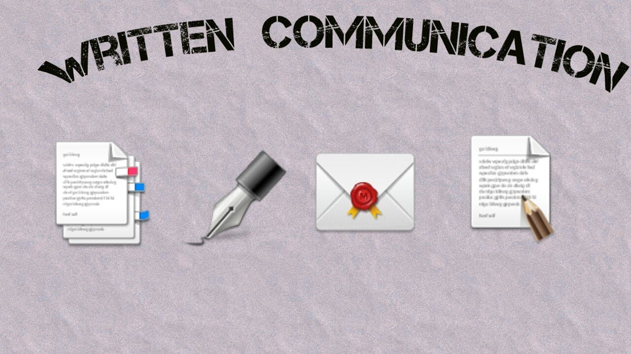
Write Communication
Professional Image: Adhering to email etiquette and proper documentation maintains a polished and credible professional image.
Clarity and Efficiency: Well-crafted communication enhances clarity and efficiency in conveying information, fostering effective collaboration and decision-making.
Effective Communication: Clear writing ensures messages are easily understood, reducing misunderstandings.

Slide 6

Active Listening
Active Listening Defined: Actively engaging in the process of fully understanding and responding to spoken communication, demonstrating genuine interest and comprehension.
Workplace Application: Enhances teamwork, minimizes misunderstandings, and promotes a positive work culture by validating others' perspectives and fostering effective communication

Slide 7
Interpersonal Skills
Positive Relationships: Establish trust and rapport through open communication and mutual respect.
Conflict Resolution: Address issues constructively, seeking solutions collaboratively for positive outcomes.
Empathy: Understand others' perspectives, fostering understanding and connection for more communication.

Slide 8

Cultural Sensitivity
Cultural awareness: Recognize diverse values.
Clarity in communication: Minimize confusion, avoid misinterpretations.
Inclusive language: Promote understanding, embrace diversity for effective and respectful interaction.

Slide 9

Professionalism
Politeness and respect: Maintain courteous language and behavior.
Clear and concise: Convey information professionally, avoiding ambiguity for effective communication.

Slide 10

Communication Channels
Face-to-face interaction: Promotes direct, immediate communication, fostering personal connections.
Virtual communication: Utilizes email and video calls for remote collaboration, enhancing flexibility.
Technology tools: Enhance collaboration, streamline processes, and facilitate efficient communication in modern work environments.

Slide 11

Over Coming Barriers
Identify barriers: Recognize communication obstacles, such as language, culture, or technology gaps.
Overcoming strategies: Implement solutions like active listening, clear messaging, or cultural sensitivity training.
Case studies: Explore real-world examples illustrating successful resolution of communication challenges.

Slide 12

Feedback
&
Improvement
Feedback importance: Vital for learning, growth, and enhancing communication effectiveness.
Constructive feedback seeking: Promotes continuous improvement, refining and honing communication skills for better interactions.

Slide 13
Real World Examples
Success scenario: Effective client presentation resulted in a lucrative deal.
Lesson: Tailor messages to the audience.
Challenge scenario: Miscommunication led to project delays.
Lesson: Prioritize clarity, confirm understanding to prevent misunderstandings, and foster collaboration.

Slide 14
Conclusion
Articulate messages clearly: Enhance communication effectiveness.
Active listening: Sharpen understanding and respond thoughtfully.
Adapt to diverse audiences: Tailor communication for maximum impact.
Seek feedback: Embrace opportunities for improvement.
Lifelong learning: Stay updated on communication trends, ensuring continued professional

Slide 15
THANK YOU

